Slide 1

High Cloud Airlines Analysis
Prepare yourself for an exhilarating journey to the World's gateway 🌎
Presented by Group 6

Slide 2

Team Members
Nainu Fathima VM
Mohammed Shibly Nazeer
Ratnam Veera Mohan Kumar

Slide 3
Agenda
Introduction
Overview
Key Contributions
Key metrics and KPI’s
Insights into the project
Summary
Conclusion

Slide 4

Introduction
High Cloud Airlines is a leading airline company that operates domestic and international flights.
This analysis aims to evaluate its operational efficiency, passenger trends, and key performance indicators (KPIs) to drive data-driven decision-making.
Conducted a comprehensive data analysis project for High Cloud Airlines to identify key trends, improve customer satisfaction, and optimize operational efficiency.
The analysis focused on flight delays, customer feedback, route profitability, and seasonal demand. Developed actionable insights to support data-driven decision-making across marketing, customer service, and logistics departments.
Based on the data available, we have examined 207 airlines that span 6 regions, operate in 106 countries, and serve 1296 cities.

Slide 5

key Contributions
Analyzed flight and customer datasets using statistical techniques and data visualization.
Identified root causes of delays and recommended operational improvements.
Segmented customer data to tailor loyalty programs and marketing campaigns.
Built interactive dashboards to present insights to stakeholders

Slide 6

KPI’s
The primary objective of this project is to analyze High Cloud Airlines' operational and passenger data to gain insights into key performance indicators (KPIs) that impact efficiency, revenue, and customer satisfaction. The analysis utilizes multiple datasets, including flight performance, carrier details, and airport information. Key date-based calculations (Year, Month, Quarter, Weekday) were created to facilitate time-based analysis.
1. Load Factor Analysis
2. Load Factor by Carrier
3. Top 10 Carriers by Passenger Preference
4. Top Routes Analysis
5. Weekend vs Weekday Load Factor
6. Flights by Distance Group

Slide 7
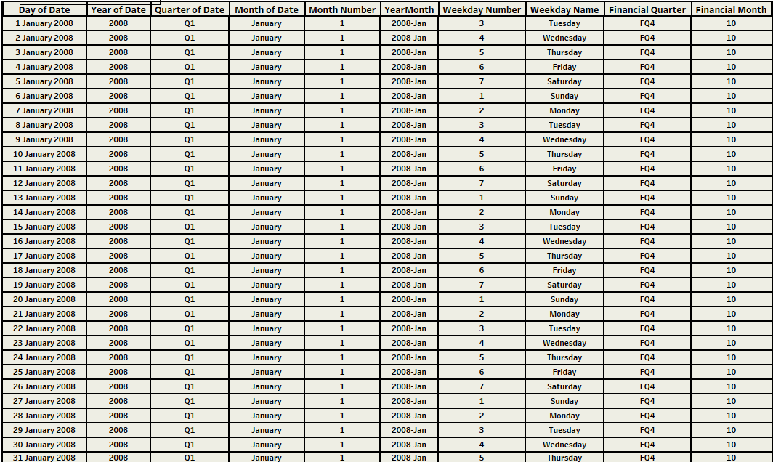
Data-Base Metrics

Slide 8
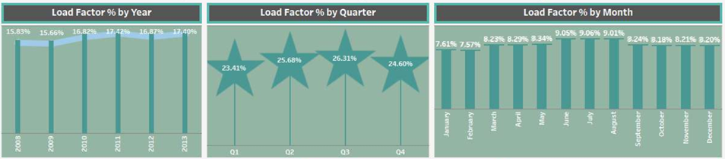
Load Factor % Analysis (Year, Quarter and Month)
The load factor is the ratio of the lift force to the aircraft's weight, representing the stress experienced by the structure during maneuvers. Understand Load Factor Performance – Evaluate seat utilization across different flights and routes.
Load Factor Formula: (Transported Passengers / Available Seats) x 100
Measured the Load Factor % on a yearly, quarterly, and monthly basis.
Trend Analysis: Between 2008 and 2013, 2011, which had the highest load factor, was notable.
Q3 had the highest Load Factor, Furthermore, July, June, and August were recognized as the peak travel months.

Slide 9

Load Factor % by Carrier
21.28%
20.53%
The capacity load factor among the evaluated airlines is led by Delta Airlines, followed by Southwest Airlines and US Airways. Delta Air Lines leads the industry in load factor measurements because it emphasizes premium services and international routes, which typically achieve higher passenger occupancy.
12.44%
11.55%
10.54%
7.98%
4.29%
4.03%
3.98%
3.38%
Delta Airlines
Southwest Airlines
Continental Airlines
US Airways
Sky-west Airlines
American Eagle Airlines
AirTran Airlines
Alaska Airlines
JetBlue Airlines
American Airlines

Slide 10
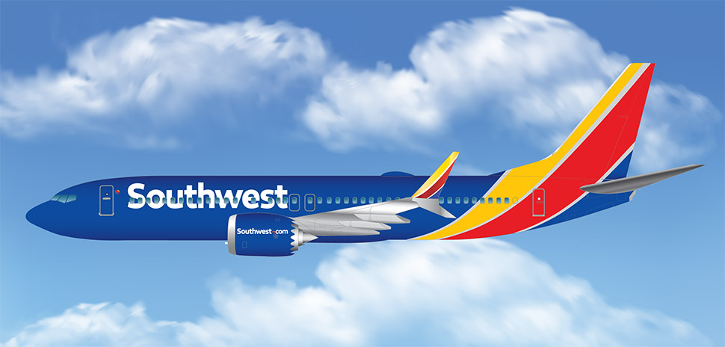
Top 10 Carriers by Passenger Preference
34.11M
The performance of the Top 10 carriers shows Southwest Airlines Co has the Highest with 34.11 M Passengers. Southwest Airlines’ success stems from a combination of factors, including its low-cost, high-efficiency business model, strong customer service, and a culture of employee empowerment and engagement. Southwest is known for its transparent pricing, with no hidden fees for checked bags or changes.
28.84M
15.65M
13.12M
7.31M
7.30M
7.13M
5.90M
4.96M
4.88M
Southwest Airlines
Delta Airlines
US Airways
Continental Airlines
JetBlue Airways
AirTran Airways
SkyWest Airlines
American Airlines
American Eagle Airlines
Alaska Airlines

Slide 11
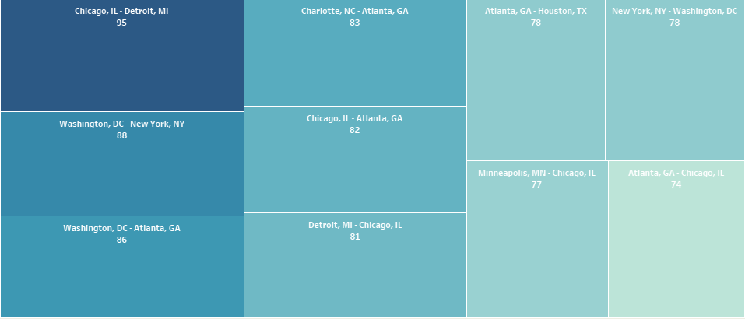
Top Routes Flight Count
The high number of flights between Chicago (ORD) and Detroit (DTW) is primarily due to the presence of major airline hubs and a large population base in both cities, making it a popular and efficient route for both business and leisure travel.
The Atlanta to Chicago route may have fewer flights than other routes due to factors like Chicago's status as a hub for United and American Airlines, while Delta's Chicago operations are split between O'Hare and Midway, and historically Delta closed its hub at ORD, shifting its focus to other major airports.

Slide 12
Weekend vs Weekday Load Factor
Weekdays typically see higher airline load factors than weekends because of a higher volume of business travel, while weekends see more leisure travel, with people leaving and returning on different days, leading to a more fluctuating demand.
To boost weekend load factors in the airline industry, airlines can implement strategies like dynamic pricing (Adjust ticket prices based on demand, time of day, and day of the week, making weekend flights more attractive), overbooking(selling more tickets than available seats, anticipating no-shows ), optimizing schedules, and offering attractive promotions while also focusing on improving customer experience and ground operations.
Weekend 28.82%
Weekday 71.18%

Slide 13


Flights by Distance Group
500-999 Miles
1500-1999 Miles
2500-2999 Miles
3500-3999 Miles
4500-4999 Miles
5500-5999 Miles
6500-6999 Miles
7500-7999 Miles
8500-8999 Miles
58,047
28.131
11,333
6092
2330
1082
855
810
612
524
419
174
145
117
83
58
32
4
1
0-500 Miles
1000-1499 Miles
2000-2499 Miles
3000-3499 Miles
4000-4499 Miles
5000-5499 Miles
6000-6499 Miles
7000-7499 Miles
8000-8499 Miles
10k-10.5k Miles
The higher number of flights within the 0-500 mile distance group likely stems from a combination of factors, including higher demand for short-haul travel, the efficiency of regional jets, and the cost-effectiveness of these routes for airlines.

Slide 14
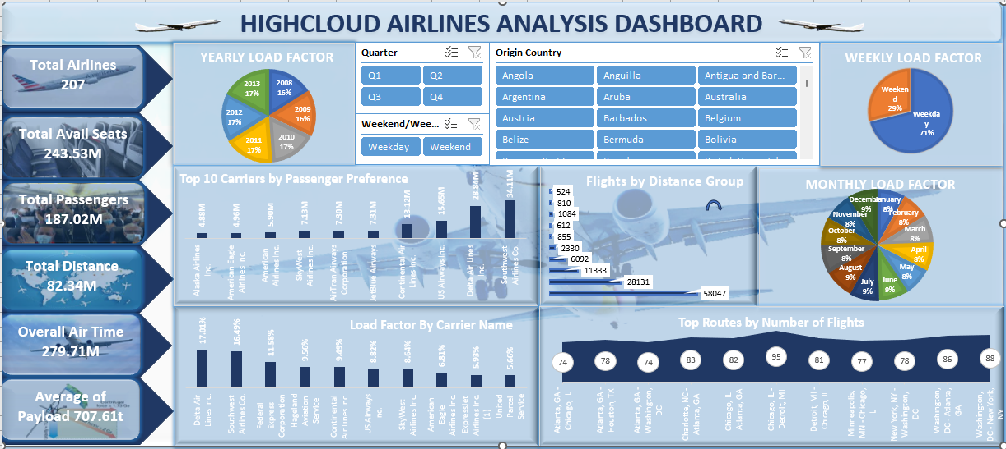
Excel Dashboard

Slide 15
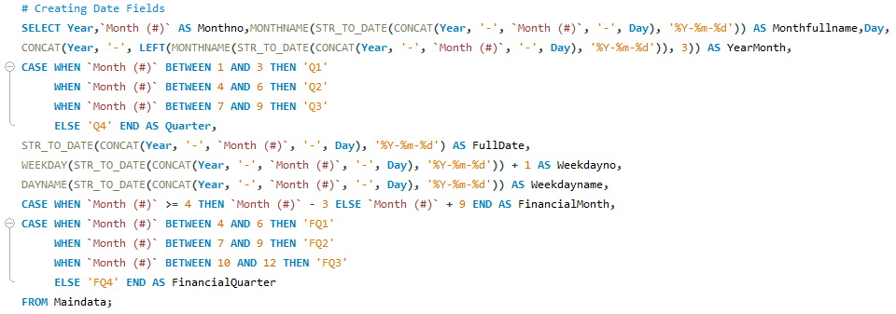
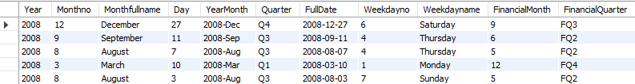
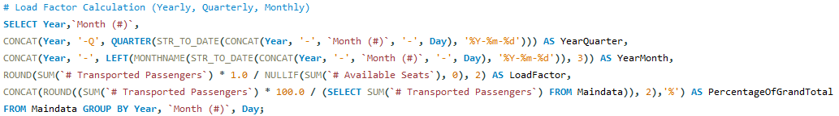
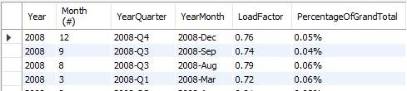
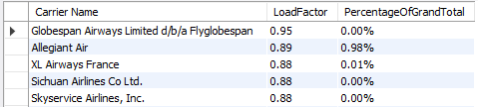
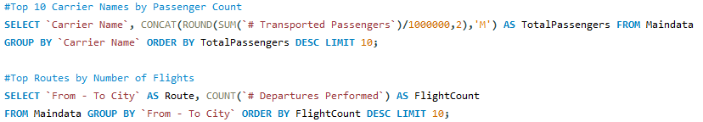
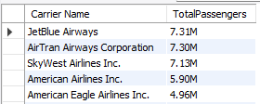
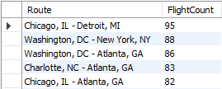

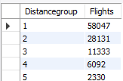
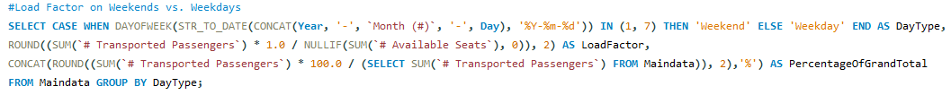
MY SQL Workbench

Slide 16
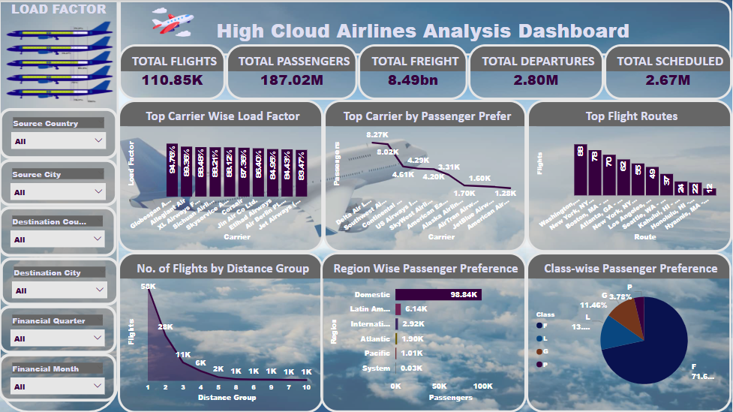
Power-bi Dashboard

Slide 17
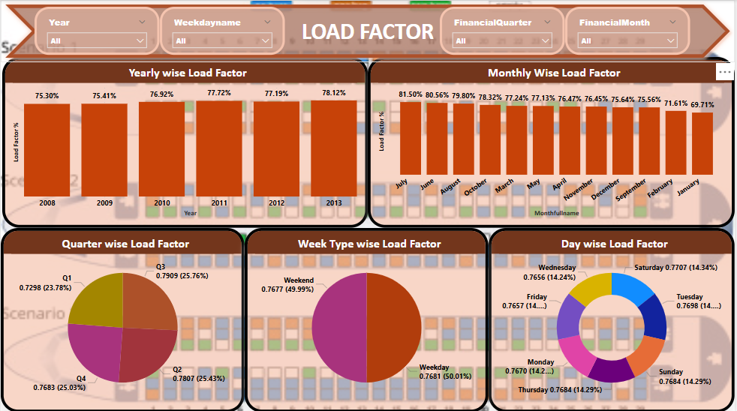

Slide 18

Tableau Dashboard

Slide 19
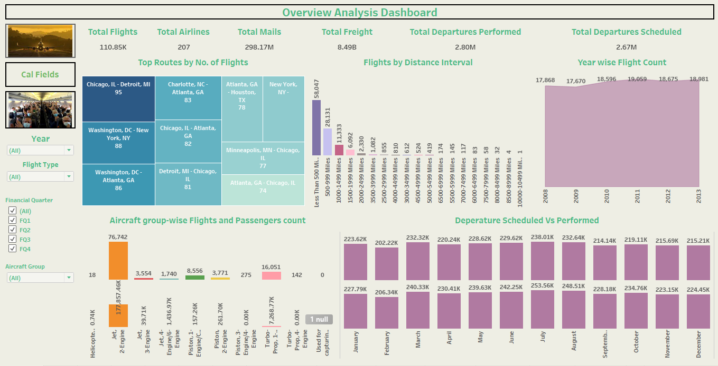

Slide 20
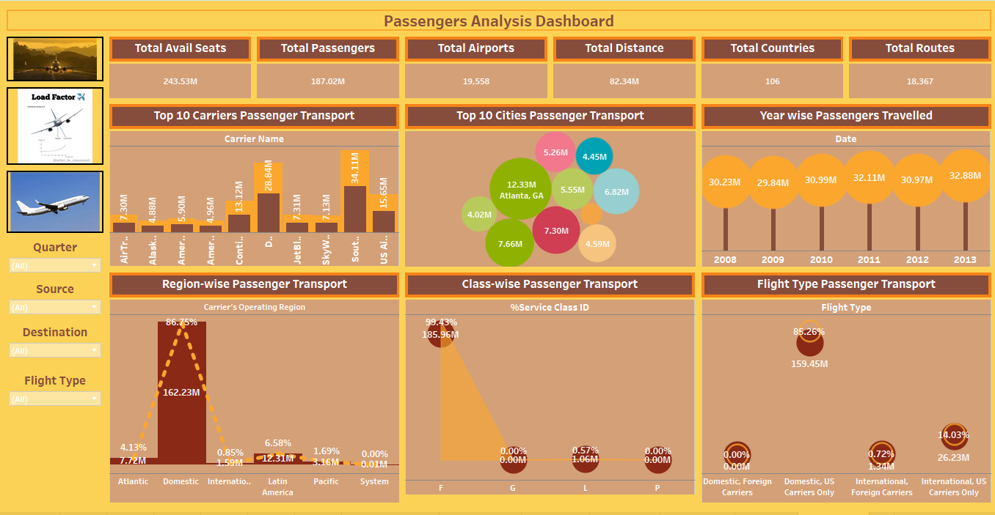

Slide 21
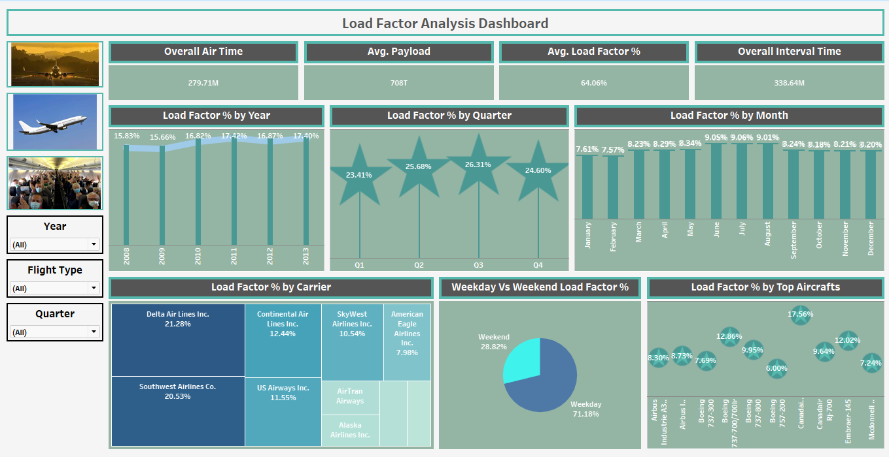

Slide 22

Insights:
The data indicates that passengers prefer weekday travel over weekends. Airlines have an opportunity to increase their flight operations within the USA, focusing on regions or routes with high demand but low competition as per this insight.
Airlines can take advantage of untapped potential and cater to the preferences of weekday travelers by expanding operations in these areas.
In order to achieve this, airlines must utilize their analysis of passenger preference to adjust flight schedules and increase the number of flights on weekdays, aligning with the observed trend. By meeting the demand for weekday travel and optimizing capacity utilization, this proactive approach can increase business profitability.
Airlines have an opportunity to grow and succeed by expanding their flight operations strategically in regions or routes with high demand on weekdays in the competitive aviation market. Using data-driven insights to adopt a proactive approach can lead to business expansion and better customer satisfaction in the long run.

Slide 23
Summary
The High Cloud Airlines Analysis Project successfully provides key insights into airline operations, passenger trends, and flight performance. By leveraging data visualization and we identified critical areas for optimization and strategic decision-making.
Key Takeaways
✅ Improved Load Factor Efficiency: The analysis of yearly, quarterly, and monthly Load Factor % helps optimize seat utilization, leading to better revenue management.
✅ Carrier & Route Performance: Identifying Top Carriers and Top Routes enables High Cloud Airlines to focus on high-demand services and improve operational efficiency.
✅ Peak Travel Trends: Insights into Weekend vs Weekday Load Factor % provide valuable data for adjusting flight schedules and pricing strategies.
✅ Optimized Distance-Based Operations: Understanding flight distribution across Distance Groups allows for better fleet and fuel management.

Slide 24

Conclusion
Airline performance and passenger travel preferences are examined, revealing a clear opportunity for airlines to improve their business operations.
By taking a proactive approach that is informed by data-driven insights, airlines can be confident in navigating the dynamic aviation landscape, ensuring sustainable growth and success in the market.
Airline profitability can be improved, and growth opportunities can be capitalized on by aligning airline schedules with passenger preferences and focusing on high-demand areas.

Slide 25

Thank you

